Slide 1
Internet Forensics

Slide 2
Domain Name System (DNS)
How DNS Works?
DNS is a global system for translating IP addresses to human-readable domain names.
When a user tries to access a web address like “example.com”, their web browser or application performs a DNS Query against a DNS server, supplying the hostname.

Slide 3
Top level Domain(TLD)
A component called a DNS Resolver is responsible for checking if the hostname is available in local cache,
and if not, contacts a series of DNS Name Servers,
until eventually it receives the IP of the service the user is trying to reach, and returns it to the browser or application.
The root is managed by IANA
The DNS Root Server extracts the Top Level Domain (TLD) from the user’s query—for example, www.example.com—and provides details for the .com TLD Name Server. In turn, that server will provide details for domains with the .com DNS zone, including “example.com”.
There are different types of TLD name server. Initially this group consisted of GOV, EDU, COM, MIL, ORG, and NET.

Slide 4
DNS Record Types
DNS servers create a DNS record to provide important information about a domain or hostname, particularly its current IP address. The most common DNS record types are:
Address Mapping record (A Record)—also known as a DNS host record, stores a hostname and its corresponding IPv4 address.
IP Version 6 Address record (AAAA Record)—stores a hostname and its corresponding IPv6 address.
Canonical Name record (CNAME Record)—can be used to alias a hostname to another hostname. When a DNS client requests a record that contains a CNAME, which points to another hostname, the DNS resolution process is repeated with the new hostname.
Mail exchanger record (MX Record)—specifies an SMTP email server for the domain, used to route outgoing emails to an email server.
Name Server records (NS Record)—specifies that a DNS Zone, such as “example.com” is delegated to a specific Authoritative Name Server, and provides the address of the name server.
Reverse-lookup Pointer records (PTR Record)—allows a DNS resolver to provide an IP address and receive a hostname (reverse DNS lookup).
Start of Authority (SOA Record)—this record appears at the beginning of a DNS zone file, and indicates the Authoritative Name Server for the current DNS zone, contact details for the domain administrator, domain serial number, and information on how frequently DNS information for this zone should be refreshed

Slide 5
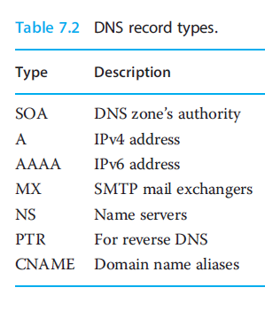
These lookups are cached for sometime determined by a value called time to live (TTL), saving network bandwidth, power ,and time

Slide 6
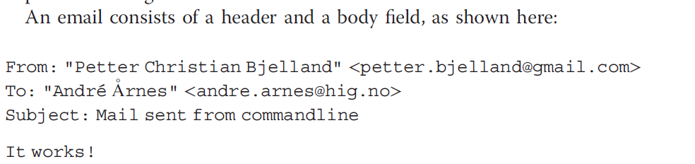
Email
Important protocols relating to the exchange of such data: the Simple Mail Transfer Protocol (SMTP), Internet Message Access Protocol (IMAP), and Post Office Protocol(POP).

Slide 7
SMTP is a widespread delivery-only protocol that pushes email from one mail server to another.
And while web mail services such as Gmail and Hotmail are using their own custom protocols for transmitting emails within their own networks (i.e.,sending email from one @gmail.com email address to another), they all use SMTP for sending emails outside their own network.
The recipients not disclosed in the email header are often referred to as BCC recipients (BCC stands for “blind carbon copy”).
The format supports attachments appended as Base64³ encoded text added as part of the email header.
Where as SMTP is a delivery-only protocol, the IMAP and POP protocols are used for managing user mail boxes and transmitting emails to the end user.

Slide 8
World Wide Web(WWW)
The World Wide Web, also known as the WWW and the Web, is an information space where documents and other web resources are identified by Uniform Resource Locators (URLs), interlinked by hypertext links, and accessible via the Internet.
Web resources are accessed using HTTP or HTTPS, which are application-level Internet protocols that use the Internet's transport protocols

Slide 9
http
HTTP is a protocol which allows the fetching of resources, such as HTML documents. It is the foundation of any data exchange on the Web and a client-server protocol
Clients and servers communicate by exchanging individual messages (as opposed to a stream of data).
The messages sent by the client, usually a Web browser, are called requests and the messages sent by the server as an answer are called responses.

Slide 10
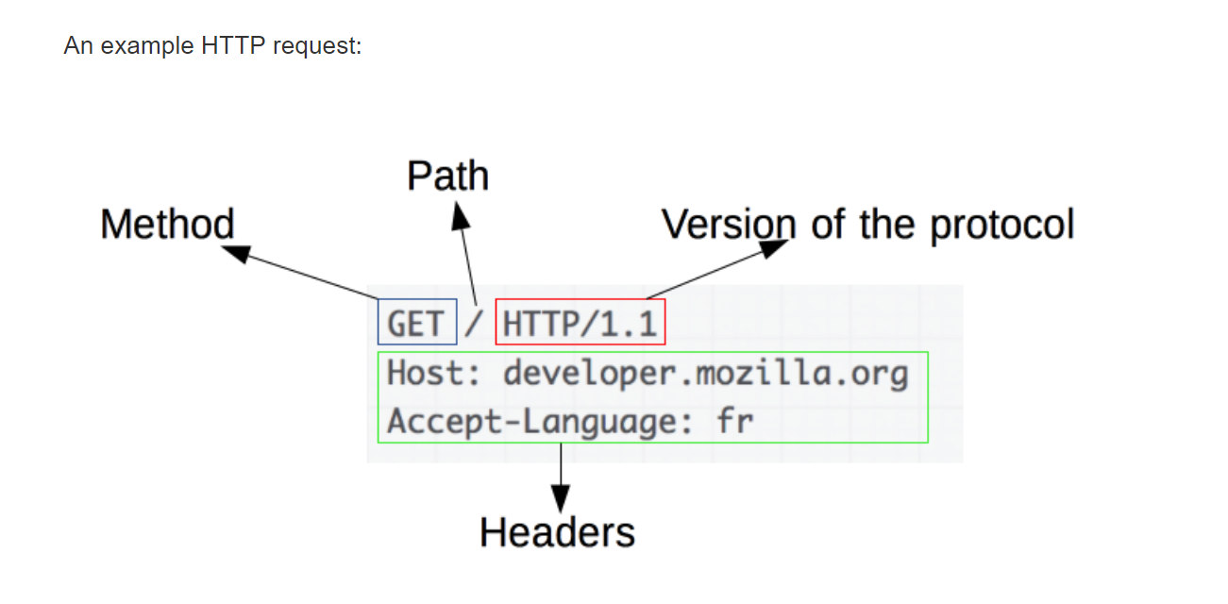
http request header:

Slide 11
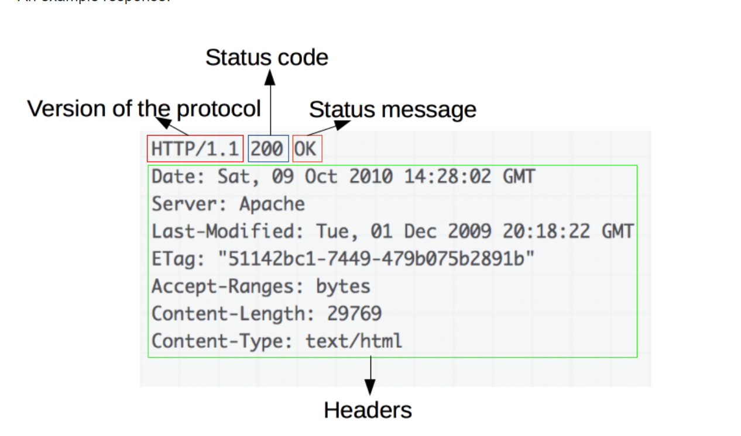
http response header

Slide 12
Peer-to-PeerNetworks
In a P2P network, the "peers" are computer systems which are connected to each other via the Internet
The only requirements for a computer to join a peer-to-peer network are an Internet connection and P2P software.
Common P2P software programs include Kazaa, Limewire, BearShare, Morpheus, and Acquisition.net
Two applications that have made a significant impact in the field: BitTorrent and the Blockchain.

Slide 13
Caveats
When you encounter Ip address that appears to be of interest in some digital evidence, there may be several reasons why that address maybe misleading or inaccurate
Two common scenarios :
Address shared by multiple endpoints
Address is a proxy for real address
Two common caveats are:
1.NAT
2. Onion Routing

Slide 14
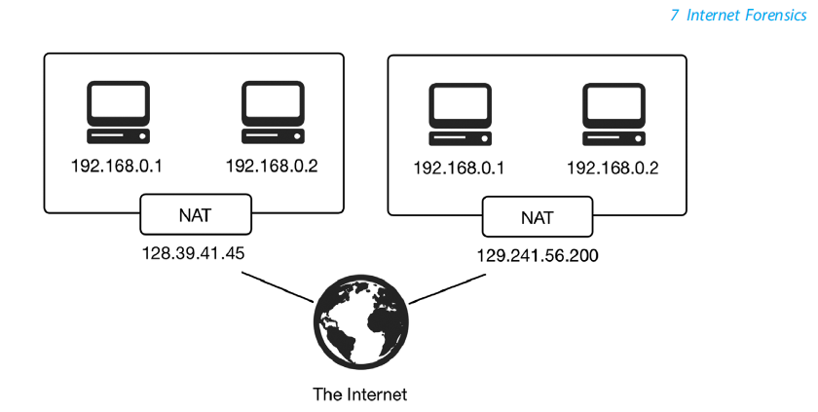
NAT
Stands for "Network Address Translation.“
NAT translates the IP addresses of computers in a local network to a single IP address.
This address is often used by the router that connects the computers to the Internet.

Slide 15
While surfing on the Internet, you may share an IP address with multiple other users. This is common on shared networks in work places and schools.
Users connected to the same wireless network typically have the same public IP address.
NAT is an Internet standard that enables a local-area network (LAN) to use one set of IP addresses for internal traffic and a second set of addresses for external traffic.
A NAT box located where the LAN meets the Internet makes all necessary IP address translations.

Slide 16
Onion Routing
Onion routing is a technique for anonymous communication over a computer network.
In an onion network, messages are encapsulated in layers of encryption, analogous to layers of an onion.
How does onion routing work?
If you are browsing the internet on a normal web browser like chrome, firefox, etc you request webpages by making simple GET requests to servers without any intermediary.
Its just a single connection between a client and a server and someone sniffing on your network can know which server your computer is contacting.

Slide 17
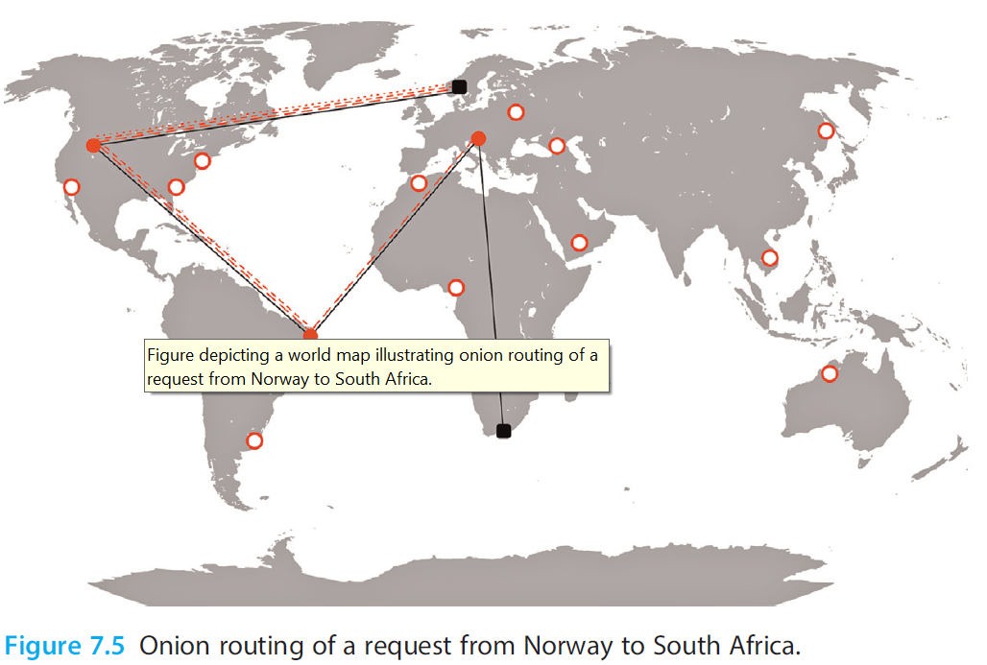

Slide 18
How does onion routing work?
In onion routing, the connection is maintained between different nodes
i.e. the connection hops from one server to another and when it reaches the last server on this circuit it is the server that we wanted to contact and it will process our request and serves us the desired webpage which is sent back to us using the same network of nodes.
Now you must thing why is it called the onion router. It is because the message we send and the responses we receive are encrypted with different keys, with a unique key for encryption for every different hop or server visit.
The client has access to all the keys but the servers only have access to the keys specific for encryption/decryption to that server.
Since this process wraps your message under layers of encryption which have to be peeled off at each different hop just like an onion that’s why its called an onion router.(TOR)

Slide 19
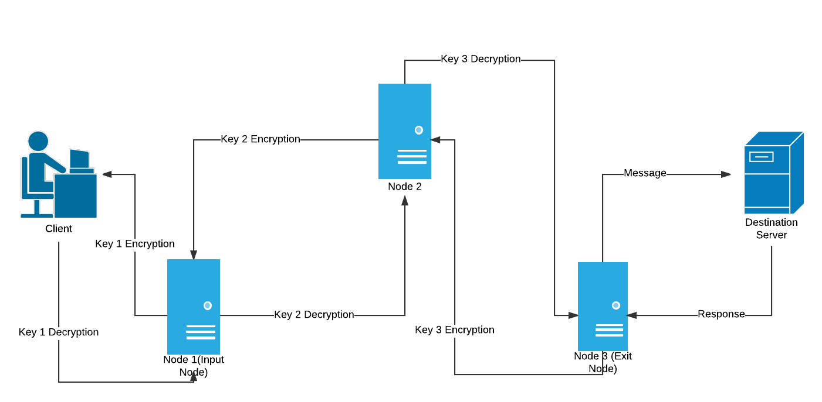
Onion Routing Example:
The result is the anonymization of the source and the intended destination of network packets.
Also helps against sniffing

Slide 20
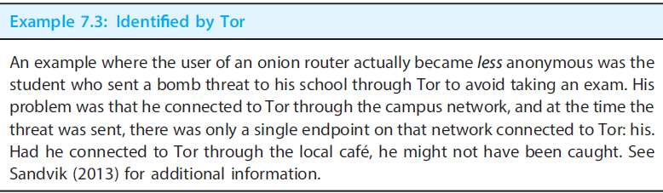

Slide 21
Web Shell
A web-shell is a malicious script used by an attacker with the intent to escalate and maintain persistent access on an already compromised web application
A web shell is a script that can be uploaded to a web server to enable remote administration of the machine
It enables the execution of programs on that server is often referred to as a webshell.
Web shells maybe as simple as a single instruction in the popular interpreter PHP:

Slide 22
Web shells can be delivered through a number of web application exploits or configuration weaknesses including:
Cross-Site Scripting;
SQL Injection;
Vulnerabilities in applications/services (e.g., WordPress or other CMS applications);

Slide 23
Tracing Information on the Internet
Gathering of information is divided into two parts:
Acquisition
Tracing
Acquisition: Collection of information from the endpoints
Tracing : Collection of information about endpoints connected to the Internet
Tracing often makes use of information publicly available on the Internet, like databases of domain or IP address ownership.

Slide 24
Tracing Information on the Internet
DNS & Reverse DNS
Whois & Reverse Whois
Ping & Port Scan
Traceroute
IP Geolocation

Slide 25
DNS & Reverse DNS
You can look up what Ip addresses a domain name points to by probing the domain name’s DNS server.
Reverse DNS Lookup is merely the reverse sequence of a DNS lookup. The Reverse DNS Lookup Tool requires you to enter the IP address that has a corresponding host name. By entering the IP address into the Reverse DNS Lookup Tool, you are able to find the domain name associated with the corresponding IP.
For example, one IP address of Google.com is 74.125.142.147. If you were to type this IP address in the Reverse DNS Lookup Tool, it will return the host name of Google as listed in the database of the Address and Routing Parameter Area (ARPA) top-level domain of the Internet.
Several tools for doing reverse DNS exist, some of the most popular being nslookup and dig.

Slide 26
Whois & Reverse Whois
This tool/Command will provide you with the IP Address owners contact information.
Whois, is a command line utility and it returns information about registered domain. Like (Registrar, Registrant, Name Server, Creation Date & Expiration Date)
Other important information includes how many IP Addresses are in the block or blocks assigned to the owner of the IP you're researching.
Services exist that enable reverse whois lookups, where one can search for domains registered to, for example, a name, phone number, or email address. If the domain is registered using a who is protection service, however, this information will not be available.

Slide 27
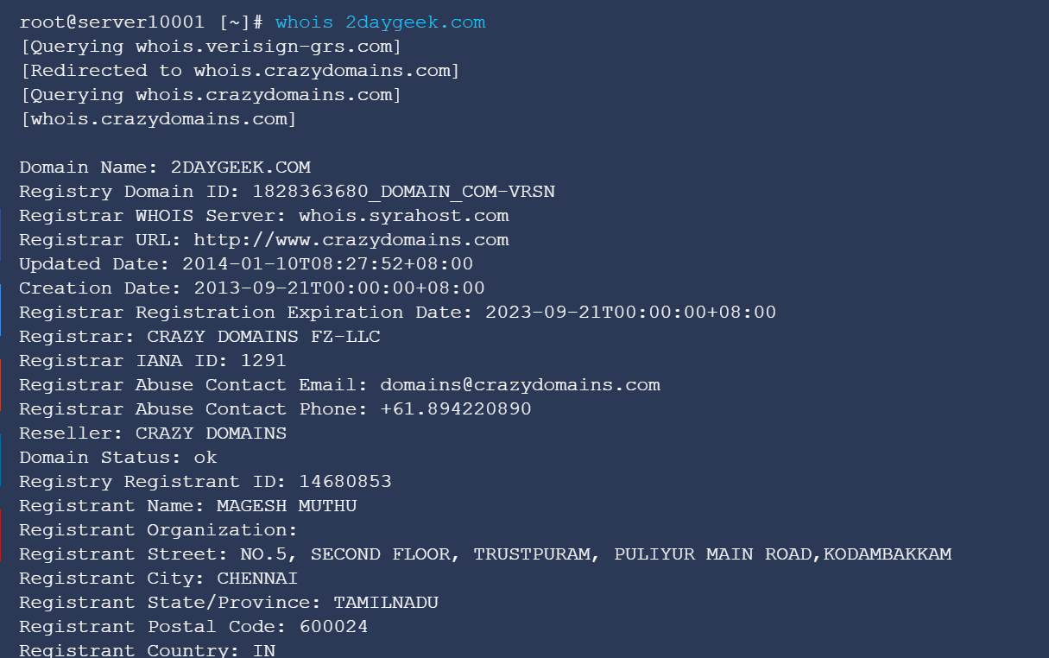

Slide 28
Ping
The ping command is a Command Prompt command used to test the ability of the source computer to reach a specified destination computer. The ping command is usually used as a simple way to verify that a computer can communicate over the network with another computer or network device.
The ping command operates by sending Internet Control Message Protocol (ICMP) Echo Request messages to the destination computer and waiting for a response. How many of those responses are returned, and how long it takes for them to return, are the two major pieces of information that the ping command provides.

Slide 29
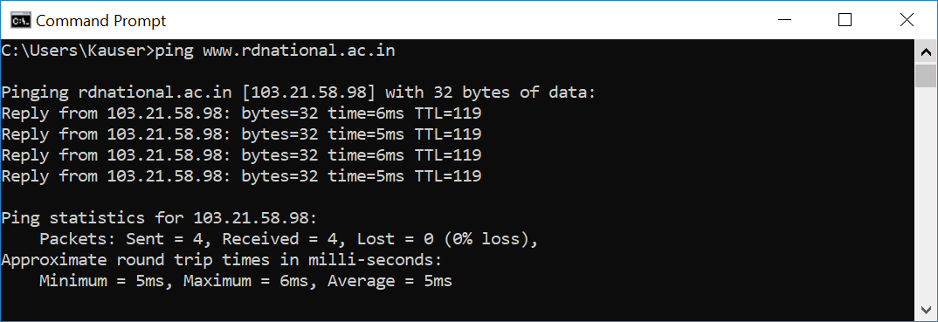

Slide 30
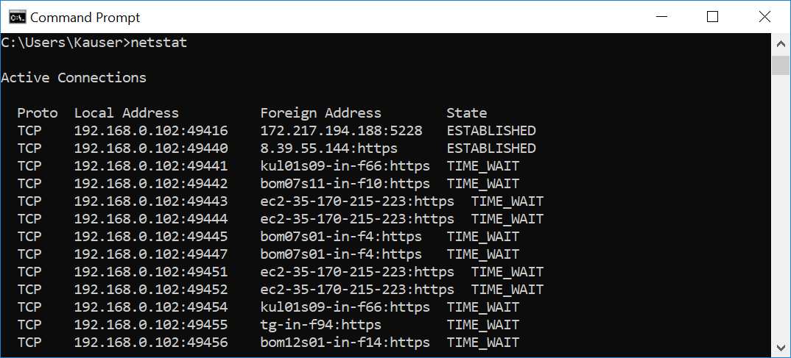
Portscan
The Windows command prompt utility netstat allows you to scan your computer to learn whether it has any programs or services listening for incoming connections over the Internet.
Active fingerprinting is the process of transmitting packets to a remote host and analysing corresponding replies.

Slide 31
Traceroute
To determine the location of an end point with ping ,portscans and DNS lookups may not be sufficient for an investigation, and you may have to determine exactly how a network packet is transmitted from one end point to another.
This entails identifying every router receiving and retransmitting the packet. When a network packet is created at an endpoint, it is assigned a number called time-to-live.
This number determines the maximum number of routers the packet may visit on its way to the destination. Every time a router receives a packet, it decrements the TTL value by one.
Traceroute, also called tracepath or tracert, is a network tool used to determine the path packets take from one IP address to another
Traceroute is a network diagnostic tool that displays the route taken by packets across a network and measures any transit delays. Most operating systems support the traceroute command.

Slide 32
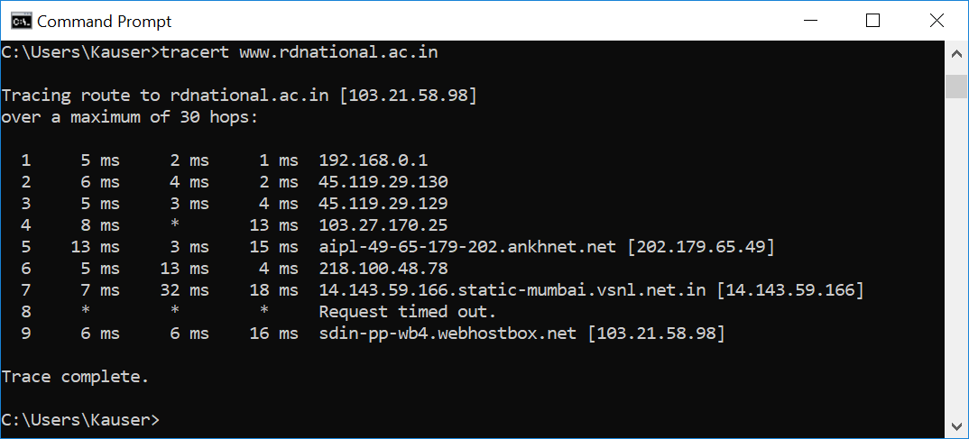

Slide 33
IP Geolocation
Geolocation is the art of determining the physical, real world location of a person or device using digital information such as an IP address.
One method for geolocation is by triangulation, we can send packets to a destination from multiple locations & we can estimate the location of the destination by triangulating the response time.

Slide 34
Collection Phases
Local Acquisition
Network Acquisition
Remote Acquisition

Slide 35
Collection Phase: Local Acquisition
The lines between computer and Internet forensics blur when it comes to local acquisition.
The artifacts we look for are accessed using the same techniques used for accessing other types of evidence that happen to reside on a computer.

Slide 36
Collection Phase: Local Acquisition
Browser History
Browser Cache
Browser Cookies
Email
Messaging & Chats
IoT

Slide 37
Browser Cache

Slide 38
Messaging & chats
Whereas older instant messaging architectures like Microsoft Network (MSN) were client–server based, modern services like Skype, ICQ, and XMPP are peer-to-peer
In addition, multiple layers of encryption maybe used.
For instance, the network connection between clients may be encrypted using SSL, while messages maybe encrypted using technologies such as pretty good privacy or off-the-record(OTR).
In these cases, it maybe impossible to recover the messages unless we come across decrypted copies of the messages, or the private keys used for encryption.
The messages have to be decrypted for the user to read them.
Applications may also store chat history as a convenience for the user.
These logs maybe the decrypted versions of messages

Slide 39
IoT
IoT is a term for the trend by which a continuously more diverse set of devices are connected to the Internet.
Eg: Internet-connected fire & burglary alarms, fridges, and power monitors are becoming common place gadgets.
Some major challenges with IoT devices are proprietary formats (how data is stored), protocols (how data is transmitted), and interfaces (how data maybe acquired).
Though some standardization maybe put in place at some point, data collection from these sources will likely be a costly and time-consuming process in the time to come.

Slide 40
Network Acquisition
Tcpdump & pcap:
Important to store every single packet passing over network for a certain amt of time
Or capture post incident network traffic
Tools used for this is tcap and stored in the format pcap
Tcpdump is a CLI tool. You can run it remotely in an ssh session, it accepts a lot of filters and allows you to display data about packets going in and out of an interface.
We can save file by xyz.pcap name and then open that pcap file in wireshark. Wireshark also uses pcap library for reading captured packets.
Wireshark:This is a GUI based tool , which accepts the input. The input is same as created by the tcpdump. It also uses libpacp lib , so that it can also capture the packets, directly from interface. The wireshark , can be used to decode and analyze a packet captured.

Slide 41
Remote Acquisition
This refers to the acquisition of artifacts that have been generated on endpoints not directly used by those involved, such as web servers, or on endpoints we do not have physical control over, such as websites, social media, and other open sources.
Server:
web server artifacts
web application
Virtual host
Cloud Services
Open sources

Slide 42
1. Web Server Logs
The artifacts generated on servers from the use of the Internet are usually in the form of logs.
These logs are usually in a readable text format that can be parsed and structured by software tools.
They are generated by a class of software called webservers.
Three popular webservers are Nginx, Apache2, and MicrosoftIIS.

Slide 43
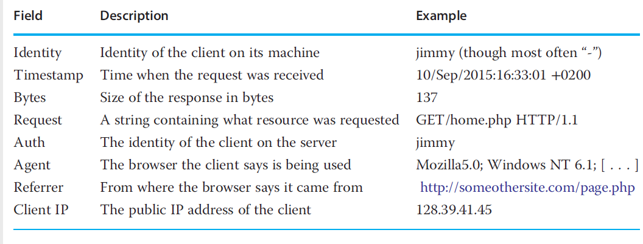
A log entry generated by webservers corresponds to a single HTTP or HTTPS request and usually contains the following fields

Slide 44
2.Web Application Logs
When the web server receives an incoming request from a client, it determines what running process on the server should handle the request.
These processes maybe built
From a number of different technologies, like PHP, Python, Java, and C#.
While each web application is free to maintain (or keep) logs exactly how it chooses, there is a tendency toward a standard logging format
These files reside in the operating system’s standard log directory (like/var/logonLinux); however, application developers may choose to store log files where they see fit.
Another normal location for application log files is next to where the web application (script or compiled computer code)resides.

Slide 45
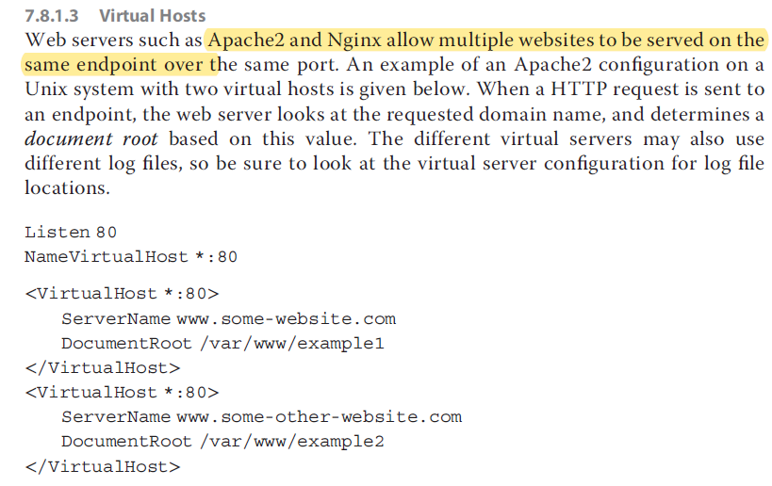

Slide 46
Cloud Services
Cloud Forensics is cross-discipline between Cloud Computing and Digital Forensics. Cloud Forensics is actually an application within Digital Forensics which oversees the crime committed over the cloud and investigates on it. Cloud computing is based on huge network, which spreads globally.
The Cloud Service Provider must communicate with third-parties for their expertise in the Investigation. They may hire IT professionals who are experts in systems, networks, security, ethical hacking, cloud architects and cloud security who can assist investigators at crime scenes.
Incident Handlers, who respond to data leakage and loss, breach of confidentiality, denial of service attacks, insider attacks, and malicious code infections.

Slide 47
Open Source
The term open source is used about information and resources that are publicly available, and this section focuses on information publicly available from remote end points.
This includes various types of websites on the Internet.
Open source artifacts maybe deployed in both reactive and proactive investigations.
Reactive investigations (let’s call them open source forensics)
Proactive use of open source artifacts, demonstrated when the investigation is not a response to a particular incident but rather in preparation for future incidents, is primarily referred to as open source intelligence.

Slide 48
Open Source
We focus on the types of open source information that maybe of interest to an investigation.
We categorize them as follows:
Personal information,(PII)-social media
User accounts,-FB/twitter/linkedin/emailadresses
Contact lists, -mutual friends/followers/following /contacts
Publication of content, -blogs/post/forums/
Interaction with content, -comments/likes
Public interaction-comments/likes on other forums
association with groups & communities-fb groupjoins/committee/likes

